Slide 1
Bridging the Gap: Meaningful Community Engagement through Online Platforms

Slide 2
Before COVID-19 with in-person engagement and programming, developing measures to track successful engagement was a bit simpler:
How many people bought tickets or registered for our event?
How many volunteers have we recruited/trained?
How many youth participants attended our programming?
What outcomes did we see from our programming or what is our pre- and post-program survey data?
Measures of Engagement Have Changed

Slide 3
Phase 1
Phase 3
Phase 2
Phase 4
In person engagement is the only real way to connect; no websites, social media networks, or digital engagement is available.
Smartphones and social media rise in popularity. Websites, email marketing, and social media provide a new avenue for digital engagement (sales, fundraising, content delivery)
Websites and email start to become widespread for content. Still no widely used ways of digital engagement and community building for nonprofits and businesses.
Digital engagement is critical and in some cases, more important in developing relationships than in-person contact. COVID-19 has accelerated this trend.
Online Engagement is Becoming the “New Normal”

Slide 4
Full remote and/or flex working arrangements will likely continue to be popular and common.
Generational shifts and expectations will continue to drive trends for increased online and digital engagement opportunities (Gen X and Xennials*, Millennials**, Gen Y, Gen Z*, Gen A**)
By definition, online and digital engagement gives you the opportunity to reach a larger potential audience
No matter what size your nonprofit is or who your audience is, these trends will affect you to some degree.
New Work Trends and Generational Shifts to Online & Digital Engagement

Slide 5
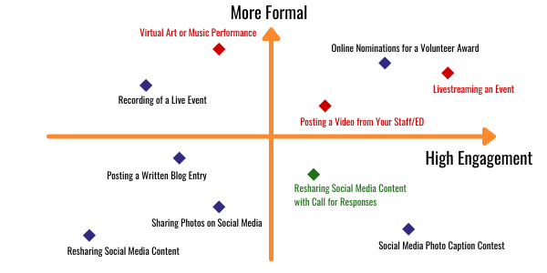
3 FACTORS TO DECIDE YOUR CONTENT:
YOUR CAPACITY
YOUR GOALS
YOUR AUDIENCE
What Online Content and Engagement Strategies Will Work for My Nonprofit?
Notes:
74% of customers consider word of mouth to be the key influencer in their purchasing decisions
88% of people trust online reviews as much as recommendations from personal contacts
64% of marketing executives indicated that they believe word of mouth is the most effective form of marketing - 6% say they have mastered it (2014).

Slide 6
Key Questions for Planning Online
Engagement
What capacity do we have for creating content, developing strategy, and measuring impact?
What audience(s) are most important to reach for our organizational and strategic planning goals?
Are we currently on the right platforms and using the right content to engage those audiences?
Do we have the budget, systems, and technical capacity (in-house or hired) to meet our engagement goals?

Slide 7
RELATIONSHIP
Following up with audience members who engage as needed to further involve them in your work or supporting your organization.
ENGAGEMENT
Online content or engagement that invites them to respond, reply, or includes a Call to Action.
CONSUMPTION
Receiving content or communication to inform or update about your work.
Beyond Likes and Views: Moving Your Audience to Action

Slide 8
Social Media Alone is NOT an Online Engagement Strategy

Slide 9
Social Media
is an Entry Point for Engagement
Social Media can be your “hook” to get people interested in your organization; deeper engagement comes from clearly defining what steps they can take next to get involved.
Some common next steps could be:
Signing up for a newsletter (even better if you have segments set up);
Asking them to take specific action (contacting a local official, sharing content, contacting your staff);
Visiting a specific related page on your website;
Donating to a fundraising campaign;
Confirming interest in volunteering;

Slide 10
Who Are Your
Potential Ambassadors and Champions?
Current and Former Board Members
Volunteers
Staff Members / Staff Leadership
Community Members Affected by Your Work / Mission
Long-Time Donors and Funders
Local Elected Officials and Government
Your Most Loyal / Engaged Social Media Followers
Mission-Aligned Celebrities, Local Personalities, Businesses, or Media Outlets

Slide 11
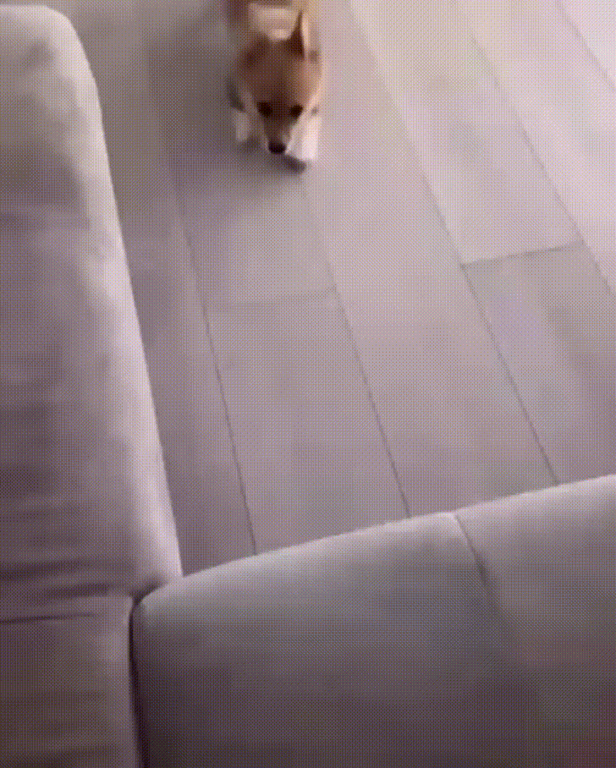
“One area where I think we are especially distinctive is failure. I believe we are the best place in the world to fail (we have plenty of practice!), and failure and invention are inseparable twins. To invent you have to experiment, and if you know in advance that it's going to work, it's not an experiment.”
Experimentation is Good: Failure = Learning
Notes:
Individual testimonials from members about why they joined and their goals for getting even more engaged - videos would be a great touch as well and a way to highlight/thank/recognize really loyal or long-time supporters.

Slide 12
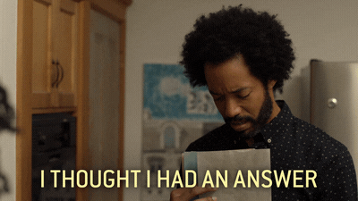
Final Questions or Requests for Resources
Notes:
Individual testimonials from members about why they joined and their goals for getting even more engaged - videos would be a great touch as well and a way to highlight/thank/recognize really loyal or long-time supporters.

Slide 13
